Slide 1
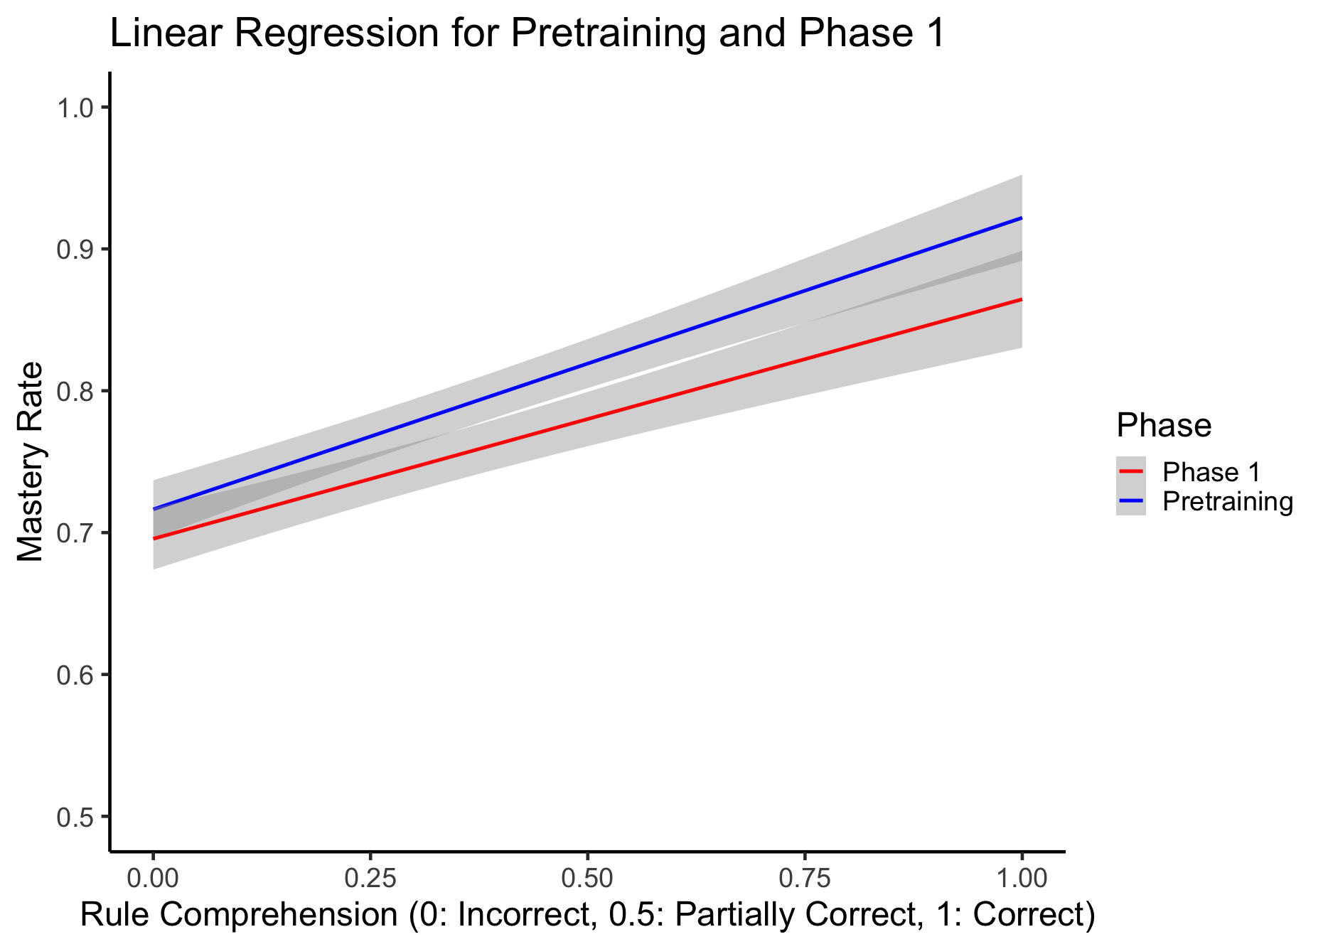
OAK Lab - Relational Rule Learning
Researcher: Helen Peng | Date: December 6, 2024
Objective: Investigate how the level of understanding relational rule affect one’s ability to master tasks.
Methods & Skills Developed: Created and applied coding scheme for responses (What was the rule?) Utilized R for data analysis, developed hypothesis testing skills.
Pre Training Phase (Easier Task):
Participants with correct rule comprehension had significantly higher mastery compared to those with partial or incorrect understanding.
Partial understanding offered no measurable benefits over incorrect comprehension.
Phase 1 (Harder Task):
Correct group outperformed Partial and Incorrect groups.
Partial group outperformed Incorrect group.
Implications: Easier tasks show little difference between the Partial and Incorrect groups, while harder tasks reveal gaps in understanding.
Thus, it is more important to focus on achieving full comprehension early on, especially for more complex tasks.

Slide 2
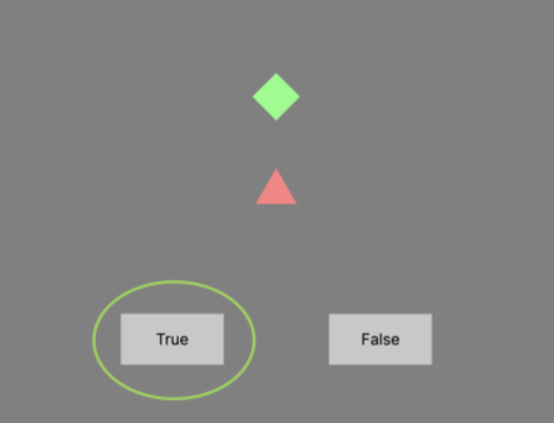
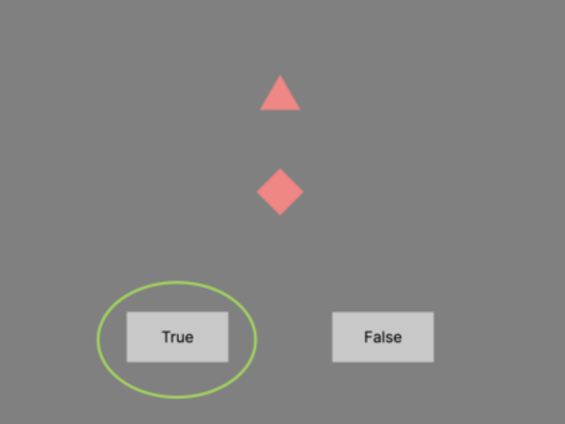
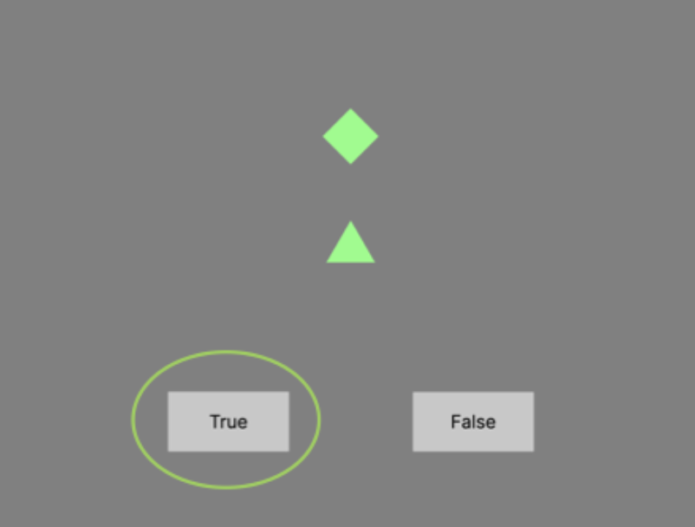
Methods
Notes:
When I presented this in the lab, most members were already familiar with the study’s methodology. But for context here, I’ve included a brief overview of the methods.
In this experiment, participants began with a pretraining session, assigned to one of four conditions—mixed, bothgreen, bothred, or phase 1 —each with a unique relational rule that they needed to figure out.
In the mixed condition, the rule was: if the green shape is on top, then it’s true.
In the bothred condition, the rule was: if the shape on top has fewer sides or vertices than the one on the bottom, then it’s true.
In the bothgreen condition, the rule was: if the shape on top has more sides or vertices than the one on the bottom, then it’s true.
In the phase 1 condition, all three rules were presented interleaved.
To proceed, participants needed to complete either ten minutes or achieve 12 correct responses in a row. After pretraining, all participants moved to the phase 1 session in which they were presented with all three rules.
Then for data preparation, I reviewed all responses and categorized them as correct, partially correct, or incorrect.
Criteria for partial correctness included mentioning vertices or sides for the bothred and bothgreen conditions or mentioning position in mixed, getting at least one rule correct for phase 1

